Slide 1

GUDLAVALLERU ENGINEERING COLLEGE
ELECTRONICS AND COMMUNCATION ENGINEERING
PRESENTED BY:ECE-D
18481A04J9
18481A04K0
18481A04K1
18481A04K2
18481A04K3

Slide 2
SMART MONITORING SYSTEM FOR INFANT INCUBATOR

Slide 3
CONTENTS :
INTRODUCON
OBJECTIVES
BLOCK DIAGRAM
HISTORY OF INCUBATOR
NODE RED
CODE
ADVANTAGES
DISADVANTAGES
CONCLUSON

Slide 4
INTRODUCTION :
Baby incubators plays a vital role in life saving of premature babies.
Incubator is a box enclosure with requisite temperature,gases, such as oxygen and carbondioxde with controlled pressure,humidity in which a pre-mature or ill infant is kept under observation and care.
It also includes a heater which is used to maintain the temperature.
It also mantains the humidity and oxygen content is maintained and accessing port for handling the baby.

Slide 5
OBJECTIVES:
The main objective is to create a system for premature babies that can give them a perfect atmosphere around them,which will help them to survive in there conditions with low cost and less maintenance.
It also help in monitoring their body temperature,humidity,heart beat.
To build prototype of a baby incubator monitoring system by utilizing IoT based communication technology and various sensor modules that are already available to be sent to the server and can be accessed mobile .
To capture and analyze the voice of the baby(crying) and decide the condition of the baby.
To increase the safety aspect by giving a warning of problems if there are irregularities in the baby incubator environment.

Slide 6
HISTORY OF INCUBATOR:
Before the medical intervention,pre mature and ill babies were born and taken care at home.
The first infant incubator was designed and developed using the chicken egg hatching.
Doctor stephane is the father of the incubator,who first aimed to keep the pre-mature babies in the warm environment in incubator like as in mother’s womb
By 1920’s the hospitals caring the premature new born infants in a separate area called the “NEONANTAL INTENSIVE CARE UNIT”(NICU).
By 1970’s every hospital established NICU,s as a necessary part in its area.
By 1980,s atmost birth took place only in the hospitals.

Slide 7
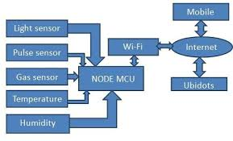
BLOCK DIAGRAM:

Slide 8
NODE RED:
Node –red is a flow based development tool for visual programming developed originally by IBM for wiring together hardware devices,APIs and online services as part of the Internet of things.
Node-Red provides a web browser-based flow editor,which can be used to create Javascript functions.Elements of applications can be saved or shared for re-use.The runtime is built on Node.js.The flow created in Node-Red are stored using JSON.
Node-RED is a tool for programming visually.It displays relations and functions visually,and allows the user to program without having to type a language.
Node-RED is a browser-based flow editor where you can add or remove nodes and write them together in order to make them communicate with each other.

Slide 9
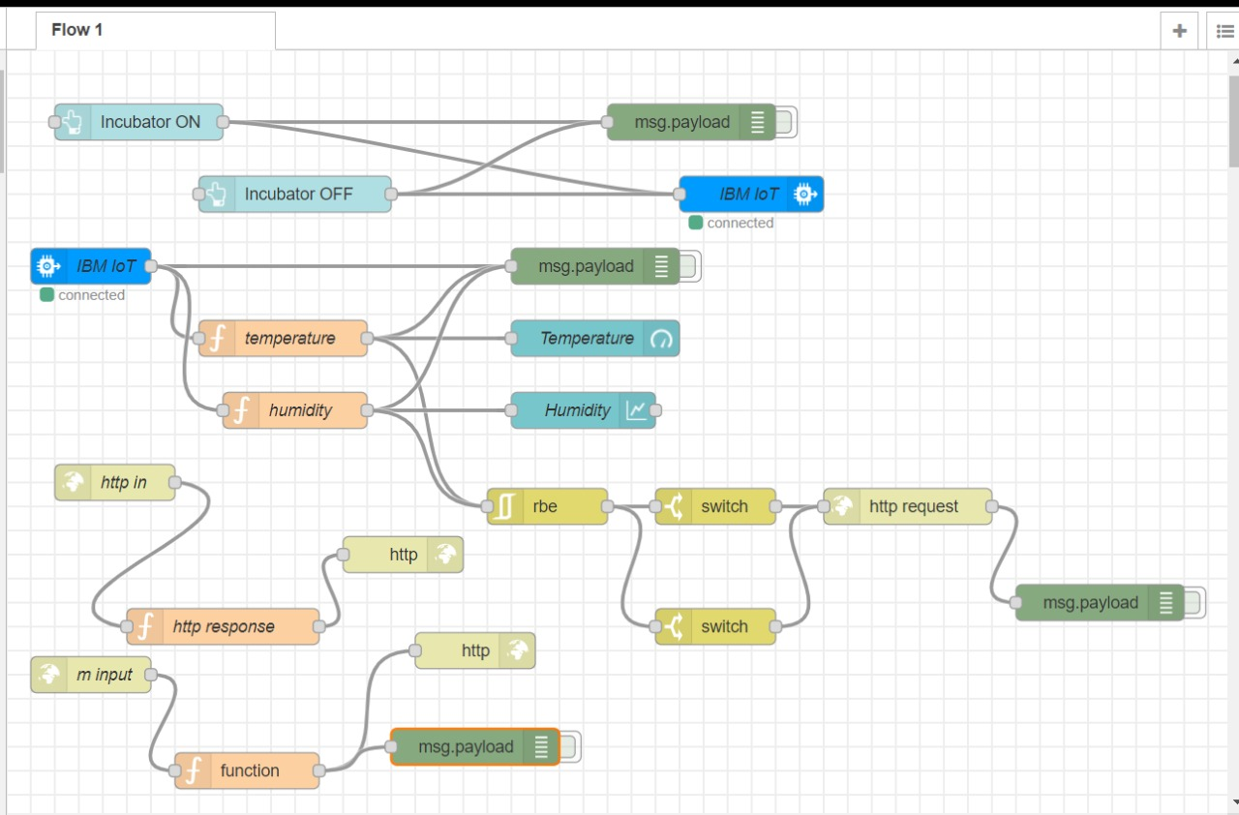

Slide 10
CODE:
import time
import sys
import ibmiotf.application
import ibmiotf.device
import random
import json
#provide your IBM Watson
Device Credentials
Organisation = “nn5kou”
device Type = “iotdevice”
deviceld = “1005”
authMethod = “token”
authToken = “1234567890”
#Intialize the device client.
T=0
H=0

Slide 11
defcommand’]==‘Incubator ON’:
print(“INCUBATOR ON IS RECEIVED”)
elif cmd .data[‘command’]==‘Incubator OFF’:
print(“INCUBATOR OFF IS RECEIVED”)
if cmd.command == “setinterval”:
print(Error-command is missing required
information : ‘interval”’)
else:
interval = cmd.data[‘interval’]
elif cmd . Command ==“print”:
if ‘message’not in cmd.data:
print(“Error-command is missing required
information:’message”’)
else:

Slide 12
print(cmd.data[‘message’])
Try:
deviceOptions={“org: organization,”type”:deviceType,“id”:deviceld,”auth-method”:authMethod,”auth-method”:
authMethod,”auth-token”:authToken}
deviceCli=
ibmiotf.device.Client(deviceOptions)
#..............................................
except Exception as e:
print(“Caught exception conneting device: %s” % str(e))
sys.exit()
#Connect and send a datapoint “hello” with value “ world” into the Cloud as an event of type
“greeting” 10 times
deviceCli.connect()

Slide 13
While True:
T=random.randint(0,56)
H=random.randint(0,60)
#Send Temperature & Humidity to LBM Watson
date = {“d”:{‘temperature’: T,’humidity’:H}}
print (date)
def myOn PublishedCallback():
print (“Published Temperature =%s
C” % t,
“Humidity=%s %%” h, “to IBM Watson”)
success = deviceCli.publishEvent(“Data”,”json”,data,qos=0, on_publish=myOnPublishCallback)
if not success:
print(Not connected to IoTF”)
time.sleep(1)
deviceCli.commandCallback= my commandCallback
#Disconnect the device and application from the cloud deviceCli.disconnect()

Slide 14
ADVANTAGES:
It provides safe environment to the baby.
Tempertaure and heart beat of the baby can be sensed easily.
Voices(crying) of the baby can be identified.
It permits early detection of potential life threatening events and maintains a safe environment for the infant.
It provides immense care for the premature infant.
Incubator acts as the mother’s womb for the babies.

Slide 15
DISADVANTAGES:
The infant incubator is relatively expensive and for this reason many health care centres especially at rural areas can’t afford.
Most incubators run on electricity,therefore when there is an acute shortage of electricity,this existing expensive baby incubator is of no use.

Slide 16
CONCLUSION:
In this project the system monitors heart beat of the infant and temperature and humidity of the surrounding.
Temperature monitoring of the infant body will help to detect many internal diseases like infections,common cold ,pneumonia have a common symptom of fever as the body temperature goes high.

Slide 17
THANK YOU

